Slide 1
Introduction to Cox Regression
Kristin Sainani Ph.D.
http://www.stanford.edu/~kcobb
Stanford University
Department of Health Research and Policy

Slide 2
History
“Regression Models and Life-Tables” by D.R. Cox, published in 1972, is one of the most frequently cited journal articles in statistics and medicine
Introduced “maximum partial likelihood”

Slide 3
Cox regression vs.logistic regression
Distinction between rate and proportion:
Incidence (hazard) rate: number of new cases of disease per population at-risk per unit time (or mortality rate, if outcome is death)
Cumulative incidence: proportion of new cases that develop in a given time period

Slide 4
Cox regression vs.logistic regression
Distinction between hazard/rate ratio and odds ratio/risk ratio:
Hazard/rate ratio: ratio of incidence rates
Odds/risk ratio: ratio of proportions
By taking into account time, you are taking into account more information than just binary yes/no.
Gain power/precision.
Logistic regression aims to estimate the odds ratio; Cox regression aims to estimate the hazard ratio

Slide 5
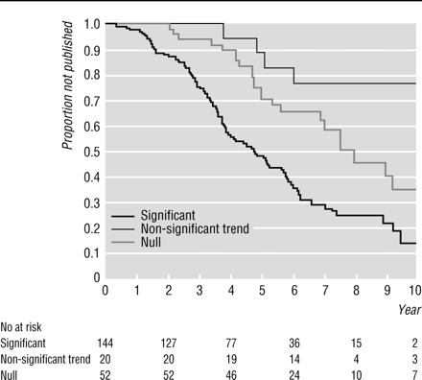
Example 1: Study of publication bias
By Kaplan-Meier methods
From: Publication bias: evidence of delayed publication in a cohort study of clinical research projects BMJ 1997;315:640-645 (13 September)

Slide 6
Univariate Cox regression
Table 4 Risk factors for time to publication using univariate Cox regression analysis
Characteristic
# not published
# published
Hazard ratio (95% CI)
Null
29
23
1.00
Non-significant trend
16
4
0.39 (0.13 to 1.12)
Significant
47
99
2.32 (1.47 to 3.66)
From: Publication bias: evidence of delayed publication in a cohort study of clinical research projects BMJ 1997;315:640-645 (13 September)
Interpretation: Significant results have a 2-fold higher incidence of publication compared to null results.

Slide 7
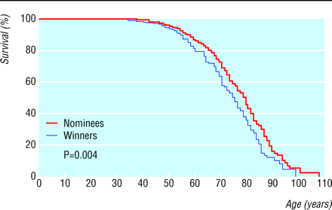
Example 2: Study of mortality in academy award winners for screenwriting
Kaplan-Meier methods
From: Longevity of screenwriters who win an academy award: longitudinal study BMJ 2001;323:1491-1496 ( 22-29 December )

Slide 8
Table 2. Death rates for screenwriters who have won an academy award. Values are percentages (95% confidence intervals) and are adjusted for the factor indicated
Relative increase in death rate for winners
Basic analysis
37 (10 to 70)
HR=1.37; interpretation: 37% higher incidence of death for winners compared with nominees
Adjusted analysis
Demographic:
Year of birth
32 (6 to 64)
Sex
36 (10 to 69)
Documented education
39 (12 to 73)
All three factors
33 (7 to 65)
Professional:
Film genre
37 (10 to 70)
HR=1.35; interpretation: 35% higher incidence of death for winners compared with nominees even after adjusting for potential confounders
Total films
39 (12 to 73)
Total four star films
40 (13 to 75)
Total nominations
43 (14 to 79)
Age at first film
36 (9 to 68)
Age at first nomination
32 (6 to 64)
All six factors
40 (11 to 76)
All nine factors
35 (7 to 70)

Slide 9
Characteristics of Cox Regression
Does not require that you choose some particular probability model to represent survival times, and is therefore more robust than parametric methods discussed last week.
Semi-parametric
(recall: Kaplan-Meier is non-parametric; exponential and Weibull are parametric)
Can accommodate both discrete and continuous measures of event times
Easy to incorporate time-dependent covariates—covariates that may change in value over the course of the observation period

Slide 10
Continuous predictors
E.g.: hmohiv dataset from the lab (higher age-group predicted worse outcome, but couldn’t be treated as continuous in KM, and magnitude not quantified):
Using Cox Regression→
The estimated coefficient for Age in the HMOHIV dataset: β=.092
HR=e^{.092}=1.096
Interpretation: 9.6% increase in mortality rate for every 1-year older in age.

Slide 11
Characteristics of Cox Regression, continued
Cox models the effect of covariates on the hazard rate but leaves the baseline hazard rate unspecified.
Does NOT assume knowledge of absolute risk.
Estimates relative rather than absolute risk.

Slide 12
Assumptions of Cox Regression
Proportional hazards assumption: the hazard for any individual is a fixed proportion of the hazard for any other individual
Multiplicative risk

Slide 13
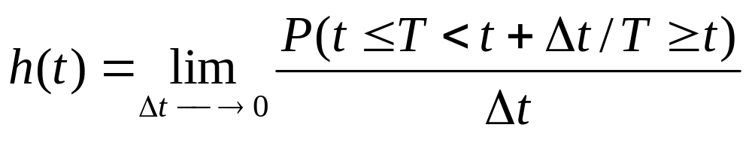
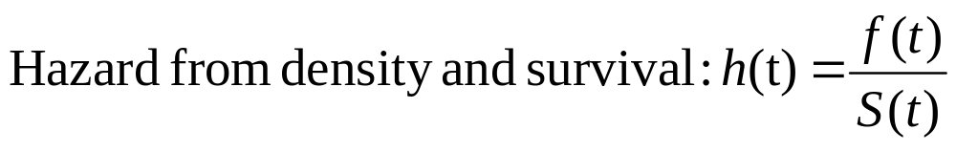
Recall: The Hazard function
In words: the probability that if you survive to t, you will succumb to the event in the next instant.

Slide 14
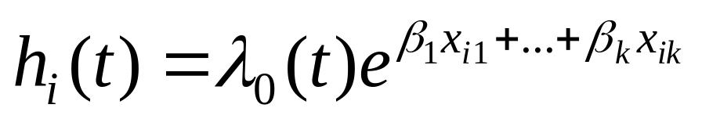
The model
Components:
A baseline hazard function that is left unspecified but must be positive (=the hazard when all covariates are 0)
A linear function of a set of k fixed covariates that is exponentiated. (=the relative risk)
Can take on any form!

Slide 15
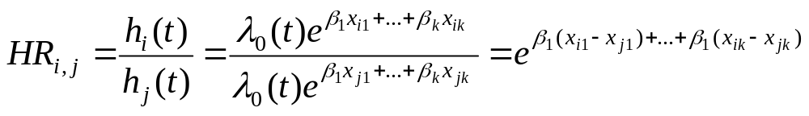
The model
Proportional hazards:
Hazard for person i (eg a smoker)
Hazard ratio
Hazard for person j (eg a non-smoker)
Hazard functions should be strictly parallel!
Produces covariate-adjusted hazard ratios!

Slide 16
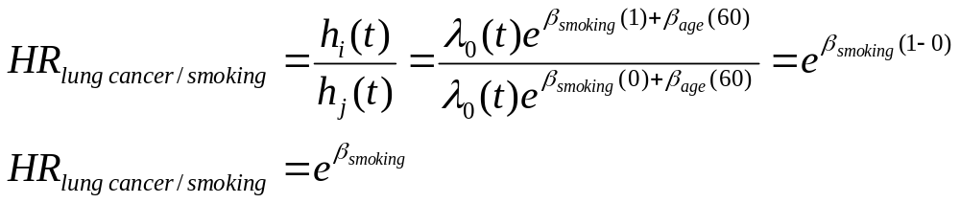
The model: binary predictor
This is the hazard ratio for smoking adjusted for age.

Slide 17
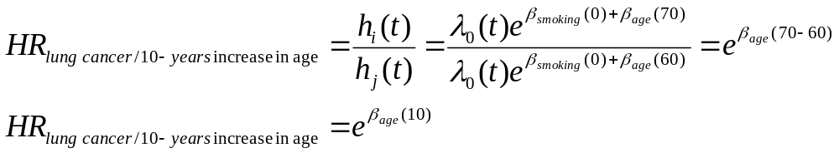
The model:continuous predictor
This is the hazard ratio for a 10-year increase in age, adjusted for smoking.
Exponentiating a continuous predictor gives you the hazard ratio for a 1-unit increase in the predictor.

Slide 18
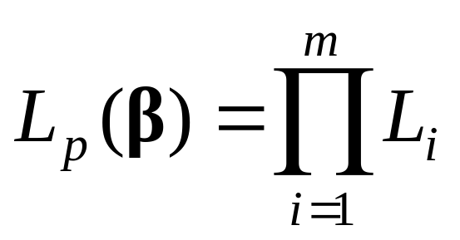
The “Partial Likelihood” (PL)
Where there are m event times (as in Kaplan-Meier methods!) and L_{i} is the partial likelihood for the i^{th} event time:

Slide 19
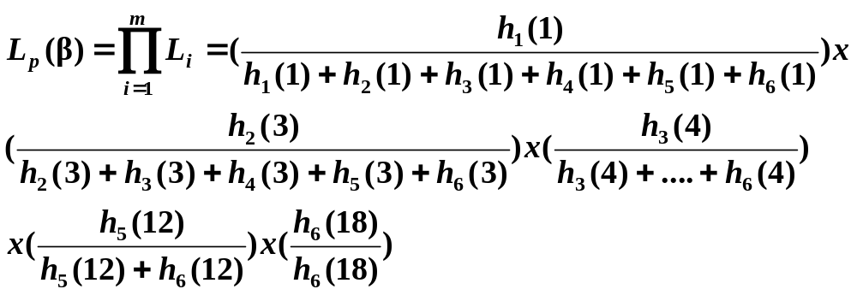
The Likelihood for each event
Consider the following data:
Males: 1, 3, 4, 10+, 12, 18
(call them subjects j=1-6)
Note: there is a term in the likelihood for each event, NOT each individual—note similarity to likelihood for conditional logistic regression…
The “risk set”
Given that a death occurred at time=3, this is the probability that it happened to subject 2 rather than to one of the other subjects at risk.

Slide 20
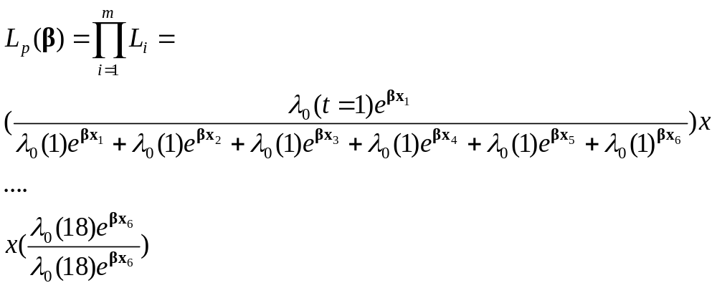
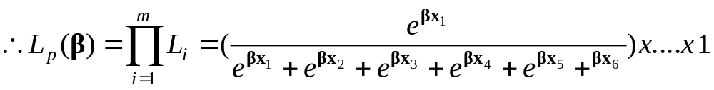
The PL

Slide 21

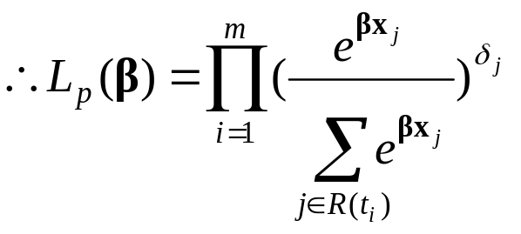
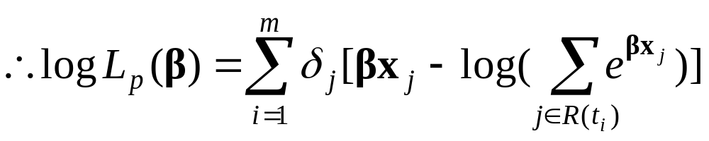
The PL
Where, is the censoring variable (1=if event, 0 if censored) and R(t_{i})is the risk set at time t_{i}
Note: we haven’t yet specified how to account for ties (later)

Slide 22
Maximum likelihood estimation…
Once you’ve written out log of the PL, then maximize the function→
  Take the derivative of the function
  Set derivative equal to 0
  Solve for the most likely values of beta (values that make the data most likely!).
  These are your ML estimates!

Slide 23
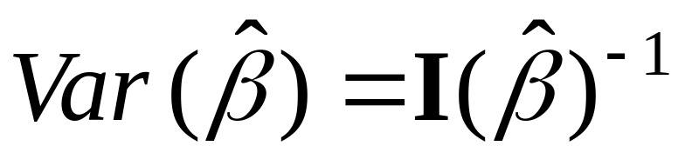
Variance of β
Standard maximum likelihood methods for variance:
Variance is the inverse of the observed information evaluated at MPLE estimate of β:

Slide 24
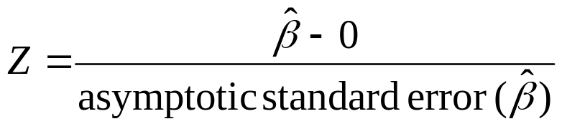
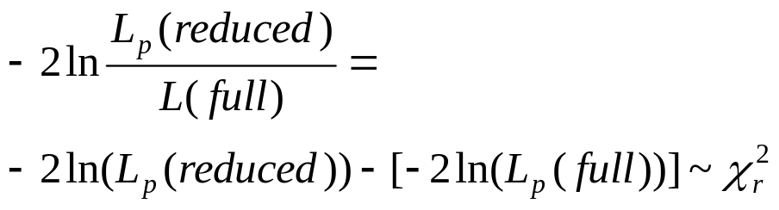
Hypothesis Testing
H₀: β=0
1. The Wald test:
  2. The Likelihood Ratio test:
  Reduced=reduced model with k parameters; Full=full model with k+r parameters

Slide 25
A quick note on ties…
The PL assumed no tied values among the observed survival times
Not often the case with real data

Slide 26
Ties
Exact method (time is continuous; ties are a result of imprecise measurement of time)
Breslow approximation (SAS default)
Efron approximation
Discrete method (treats time as discrete; ties are real)
In SAS:
option on the model statement:
ties=exact/efron/breslow/discrete

Slide 27
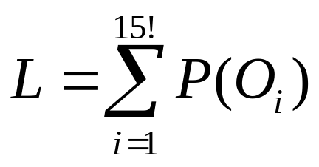
Ties: Exact method
Assumes ties result from imprecise measurement of time.
Assumes there is a true unknown order of events in time.
Mathematically, the exact method calculates the exact probability of all possible orderings of events.
For example, in the hmohiv data, there were 15 events at time=1 month. (We can assume that all patients did not die at the precise same moment but that time is measured imprecisely.) ID’s= 13, 16, 28, 32, 52, 54, 69, 72, 78, 79, 82, 83, 93, 96, 100
With 15 events, there are 15! (1.3x10¹²)different orderings.
Instead of 15 terms in the partial likelihood for 15 events, get 1 term that equals:
Where O_{i} is the i^{th} possible ordering; for example, here, 15!^{th} ordering is: 100, 96, 93, 83, 82, 79, 78, 72, 69, 54, 52, 32, 28, 16, 13

Slide 28
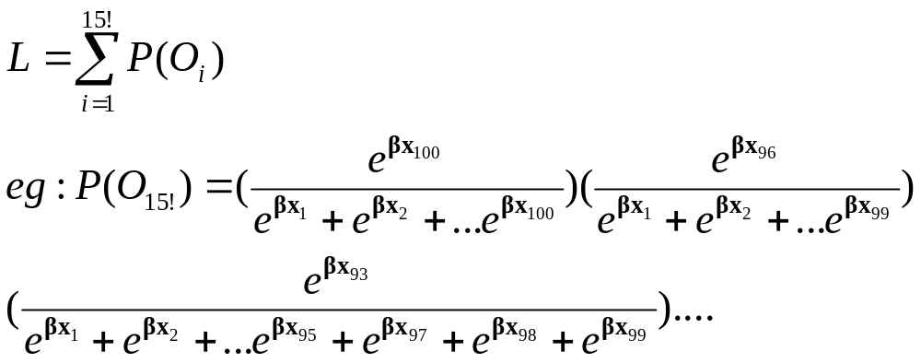
Exact, continued
Each P(O_{i}) has 15 terms; sum 15! P(O_{i})’s…
Hugely complex computation!…so need approximations…

Slide 29
Breslow and Efron methods
Breslow (1974)
Efron (1977)
Both are approximations to the exact method.
→both have much faster calculation times
→Breslow is SAS default.
→Breslow does not do well when the number of ties at a particular time point is a large proportion of the number of cases at risk.
→Prefer Efron to Breslow

Slide 30
Discrete method
Assumes time is truly discrete.
When would time be discrete?
When events are only periodic, such as:
--Winning an Olympic medal (can only happen every 4 years)
--Missing a class (can only happen on Mondays or Wednesdays at 3:15pm)
--Voting for President (can only happen every 4 years)

Slide 31
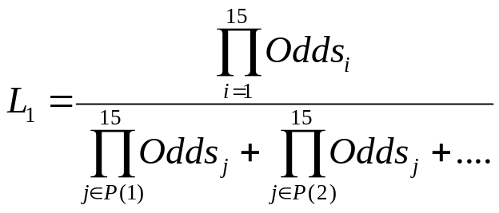
Discrete method
Models proportional odds: coefficients represent odds ratios, not hazard ratios.
For example, at time= 1 month in the hmohiv data, we could ask the question: given that 15 events occurred, what is the probability that they happened to this particular set of 15 people out of the 98 at risk at 1 month?
Odds are a function of an individual’s covariates.
Recursive algorithm makes it possible to calculate.
All possible sets of 15 out of 98!

Slide 32
Ties: conclusion
→We’ll see how to implement in SAS and compare methods (often doesn’t matter much!).

Slide 33
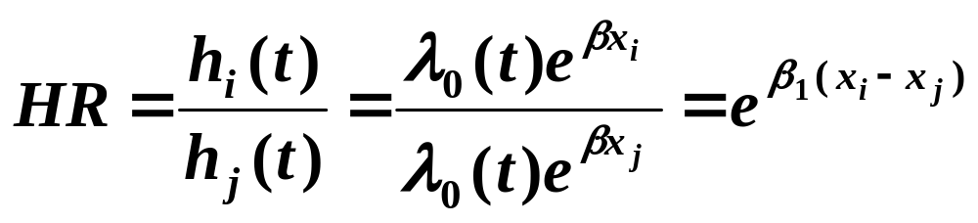
Evaluation of Proportional
Hazards assumption:
Recall proportional hazards concept:
Hazard for person i (eg a smoker)
Hazard ratio for smoking
Hazard for person j (eg a non-smoker)

Slide 34
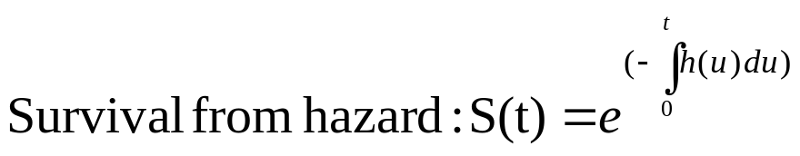
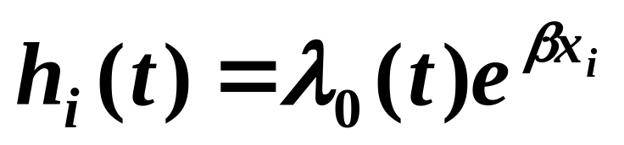
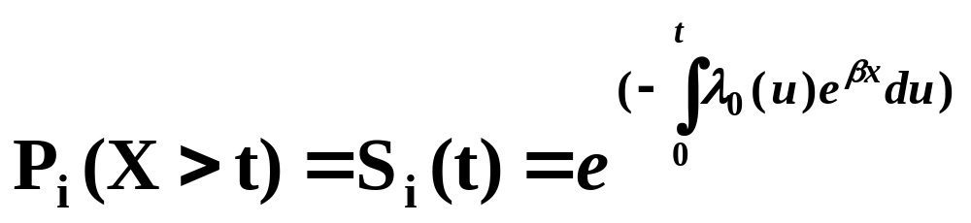
Recall relationship between survival function and hazard function…

Slide 35

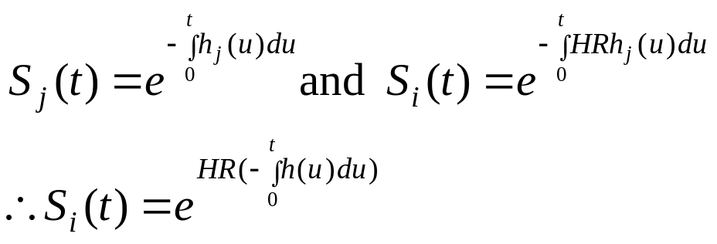
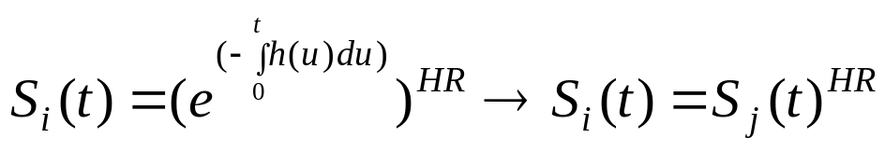
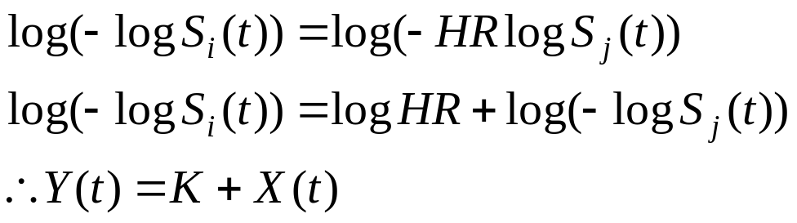
Evaluation of Proportional
Hazards assumption:
Multiply both sides by a negative and take logs again
Take log of both sides
i.e., log(-log) survival curves are parallel,
and different by log(HR)

Slide 36
Evaluation of Proportional
Hazards assumption:
e.g., graph we’ll produce in lab…

Slide 37
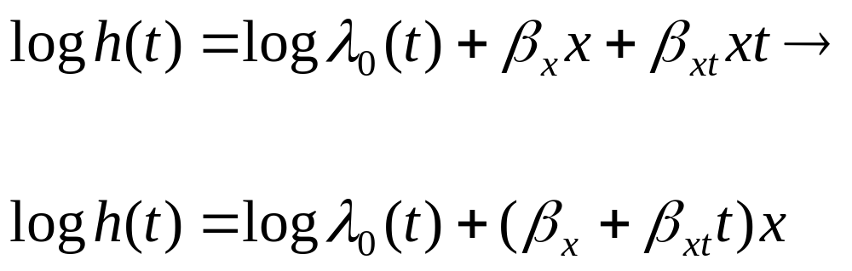
Cox models with Non-
Proportional Hazards
Violation of the PH assumption for a given covariate is equivalent to that covariate having a significant interaction with time.
Time-interaction coefficient
The covariate multiplied by time
If Interaction coefficient is significant→ indicates non-proportionality, and at the same time its inclusion in the model corrects for non-proportionality!
Negative value indicates that effect of x decreases linearly with time.
Positive value indicates that effect of x increases linearly with time.
This introduces the concept of a time-dependent covariate…

Slide 38
Time-dependent covariates
Covariate values for an individual may change over time
For example, if you are evaluating the effect of taking the drug raloxifene on breast cancer risk in an observational study, women may start and stop the drug at will. Subject A may be taking raloxifene at the time of the first event, but may have stopped taking it by the time the 15th case of breast cancer happens.
If you are evaluating the effect of weight on diabetes risk over a long study period, subjects may gain and lose large amounts of weight, making their baseline weight a less than ideal predictor.
If you are evaluating the effects of smoking on the risk of pancreatic cancer, study participants may change their smoking habits throughout the study.
Cox regression can handle these time-dependent covariates!

Slide 39
Time-dependent covariates
For example, evaluating the effect of taking oral contraceptives (OCs) on stress fracture risk in women athletes over two years—many women switch on or off OCs .
If you just examine risk by a woman’s OC-status at baseline, can’t see much effect for OCs. But, you can incorporate times of starting and stopping OCs.

Slide 40
Time-dependent covariates
Ways to look at OC use:
Not time-dependent
  Ever/never during the study
  Yes/no use at baseline
  Total months use during the study
Time-dependent
  Using OCs at event time t (yes/no)
  Months of OC use up to time t

Slide 41
Time-dependent covariates:
Example data
4 events
ID | Time | Fracture | StartOC | StopOC
1 | 12 | 1 | 0 | 12
2 | 11 | 0 | 10 | 11
3 | 20 | 1 | . | .
4 | 24 | 0 | 0 | 24
5 | 19 | 0 | 0 | 11
6 | 6 | 1 | . | .
7 | 17 | 1 | 1 | 7

Slide 42
1. Time independent predictor…
Baseline use (yes/no)

Slide 43
Time-dependent covariates
Order by Time…
ID | Time | Fracture | StartOC | StopOC
6 | 6 | 1 | . | .
2 | 11 | 0 | 10 | 11
1 | 12 | 1 | 0 | 12
7 | 17 | 1 | 1 | 7
5 | 19 | 0 | 0 | 11
3 | 20 | 1 | . | .
4 | 24 | 0 | 0 | 24

Slide 44
Time-dependent covariates
3 OC users at baseline
ID | Time | Fracture | StartOC | StopOC
6 | 6 | 1 | . | .
2 | 11 | 0 | 10 | 11
1 | 12 | 1 | 0 | 12
7 | 17 | 1 | 1 | 7
5 | 19 | 0 | 0 | 11
3 | 20 | 1 | . | .
4 | 24 | 0 | 0 | 24

Slide 45
Time-dependent covariates
4 non-users at baseline
ID | Time | Fracture | StartOC | StopOC
6 | 6 | 1 | . | .
2 | 11 | 0 | 10 | 11
1 | 12 | 1 | 0 | 12
7 | 17 | 1 | 1 | 7
5 | 19 | 0 | 0 | 11
3 | 20 | 1 | . | .
4 | 24 | 0 | 0 | 24

Slide 46
Time-dependent covariates
First event is in a non-OC user at baseline. (risk set: 3 users/4 non)
Next is a censoring (non-user)
ID | Time | Fracture | StartOC | StopOC
6 | 6 | 1 | . | .
2 | 11 | 0 | 10 | 11
1 | 12 | 1 | 0 | 12
7 | 17 | 1 | 1 | 7
5 | 19 | 0 | 0 | 11
3 | 20 | 1 | . | .
4 | 24 | 0 | 0 | 24
Second event is in a baseline user. (risk set: 3 users/2 non)
Third event is in a non-user at baseline.(risk set: 2 users/2 non)
Next is a censoring (baseline user).
Fourth and last event is in a non-user (risk set: 1 user/1 non)
Censoring.

Slide 47
The PL using baseline value of OC use

Slide 48
The PL using ever/never value of OC use
A second time-independent option would be to use the variable “ever took OCs” during the study period…

Slide 49
Time-dependent covariates
First event is in a never-user. (risk set: 5 ever users/2 never)
Next is a censoring (ever-user)
ID | Time | Fracture | StartOC | StopOC
6 | 6 | 1 | . | .
2 | 11 | 0 | 10 | 11
1 | 12 | 1 | 0 | 12
7 | 17 | 1 | 1 | 7
5 | 19 | 0 | 0 | 11
3 | 20 | 1 | . | .
4 | 24 | 0 | 0 | 24
Second event is in an ever-user. (risk set: 4 users/1 never)
Third event is in an ever-user.(risk set: 3 users/1 non)
Next is a censoring (ever user).
Fourth and last event is in a never-user (risk set: 1 user/1 non)
Censoring.

Slide 50
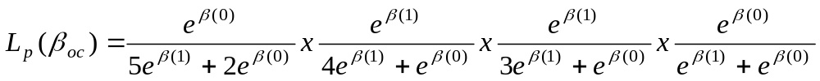
The PL using ever/never value of OC use
“Ever took OCs” during the study period

Slide 51
Time-dependent...

Slide 52
Time-dependent covariates
First event at time 6
ID | Time | Fracture | StartOC | StopOC
6 | 6 | 1 | . | .
2 | 11 | 0 | 10 | 11
1 | 12 | 1 | 0 | 12
7 | 17 | 1 | 1 | 7
5 | 19 | 0 | 0 | 11
3 | 20 | 1 | . | .
4 | 24 | 0 | 0 | 24

Slide 53
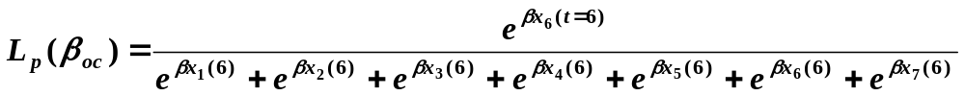
The PL at t=6
X is time-dependent

Slide 54
Time-dependent covariates
At the first event-time (6), there are 4 not on OCs and 3 on OCs.
ID | Time | Fracture | StartOC | StopOC
6 | 6 | 1 | . | .
2 | 11 | 0 | 10 | 11
1 | 12 | 1 | 0 | 12
7 | 17 | 1 | 1 | 7
5 | 19 | 0 | 0 | 11
3 | 20 | 1 | . | .
4 | 24 | 0 | 0 | 24

Slide 55
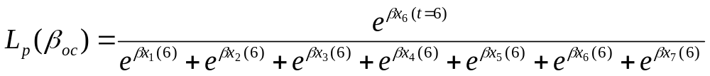
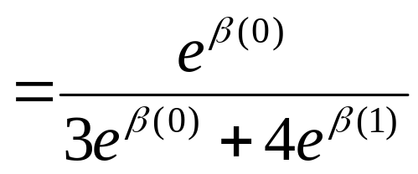
The PL at t=6

Slide 56
Time-dependent covariates
Second event at time 12
ID | Time | Fracture | StartOC | StopOC
6 | 6 | 1 | . | .
2 | 11 | 0 | 10 | 11
1 | 12 | 1 | 0 | 12
7 | 17 | 1 | 1 | 7
5 | 19 | 0 | 0 | 11
3 | 20 | 1 | . | .
4 | 24 | 0 | 0 | 24

Slide 57
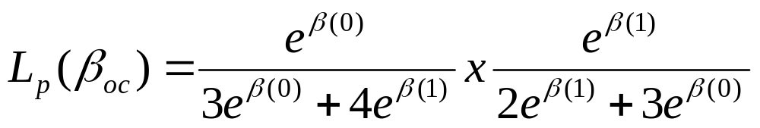
The PL at t=12

Slide 58
Time-dependent covariates
Third event at time 17
ID | Time | Fracture | StartOC | StopOC
6 | 6 | 1 | . | .
2 | 11 | 0 | 10 | 11
1 | 12 | 1 | 0 | 12
7 | 17 | 1 | 1 | 7
5 | 19 | 0 | 0 | 11
3 | 20 | 1 | . | .
4 | 24 | 0 | 0 | 24

Slide 59
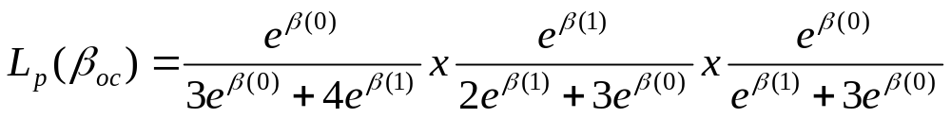
The PL at t=17

Slide 60
Time-dependent covariates
Fourth event at time 20
ID | Time | Fracture | StartOC | StopOC
6 | 6 | 1 | . | .
2 | 11 | 0 | 10 | 11
1 | 12 | 1 | 0 | 12
7 | 17 | 1 | 1 | 7
5 | 19 | 0 | 0 | 11
3 | 20 | 1 | . | .
4 | 24 | 0 | 0 | 24

Slide 61
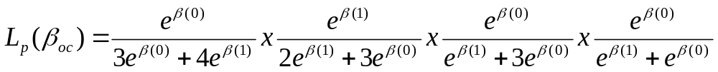
The PL at t=20
vs. PL for OC-status at baseline (from before):

Slide 62
References
Paul Allison. Survival Analysis Using SAS. SAS Institute Inc., Cary, NC: 2003.

